Slide 1
BioKind Analytics
Data Science for the Public Good Internship Program
UVA Biocomplexity
Social and Decision Analytics Division
28 June 2023

Slide 2
Project Team
University of Virginia, Biocomplexity Institute, Social and Decision Analytics
DSPG, University of Virginia, Biocomplexity Institute, Social and Decision Analytics
Anjali Mehta, Third Year @ UVA (CS Engineering & DS)
Prashanth Wagle, Grad Student @ UVA (CS)
Trinity Chamblin, Second Year @ UVA (Stats & CS)
Annie Xie, Grad Student @ CMU (Policy & DA)
Steve Zhou, Fourth Year @ UVA (CS & Math)
Sara Shallenberger, Third Year @ Carleton College (Stats)
Marijke van der Geer, Fourth Year @ SDSU (Stats & DS)
Nakshatra Yalagach, Grad Student @UVA (CS)
Jianing Cai, Fourth Year @ UVA (CS & Math)
Kate Lanman, Third Year @ Northeastern (DS & Math)
Sponsored by Alex Han, CEO of Biokind Analytics

Slide 3

BioKind Analytics
Who they are:
An organization that brings together undergraduate data scientists across the nation to provide data analytics services to healthcare nonprofits
What they want to achieve:
Advance healthcare non-profit organizations’ missions by using data science to assess current operations in order to lower costs, improve efficiencies, and predict future needs.
Where we fit in:
Answering BioKind’s research questions

Slide 4


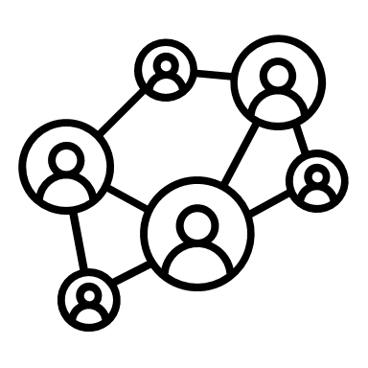
Project Description + Research Question
QUESTION: What is the effect of the economy on donations from households to health care nonprofits, and what are the factors that influence households to donate?
GOAL: Help healthcare nonprofits prepare for changes in the economy and guide their business decisions
WHAT IS A NONPROFIT? An organization operated for a collective public benefit and not for profit. Charities are one type of nonprofit.
OUR PROCESS:
Data discovery: Income, family demographics, donations to healthcare nonprofits and economic indicators
Analyze selected datasets
Discover trends between donations and the economy
4

Slide 5
Review of Literatures
Individual donors, especially higher net worth individuals, contribute approximately 75% of all donations in the United States
High investor sentiment leads to more donations
In 2018, 49.6% of the general population reported charitable giving, and households are more likely to give as their income rises.
The 2008 financial crisis resulted in decreased charitable donations due to shocks to income and wealth, as well as increased uncertainty.
Despite a lack of timely research on the effect of the COVID-19 pandemic on charitable donations, it is expected that charities will receive fewer donations

Slide 6
Data Sources
​Source Data | Description
Bureau of Labor Statistics (BLS) | Retrieved and combined Local Area Unemployment Statistics data sets for each state and manipulated into a dataset that covers the unemployment rates organized by state level (available per month and year 2001-2019+)
Panel Study of Income Dynamics (PSID) | Retrieved household-level biennial survey data about family demographics, income and donations from 2001-2019.
National Center for Charitable Statistics (NCCS) | Retrieved dataset which consists information about public charities across the US and their locations, industries and so on from 1989 - 2019

Slide 7
Methodology
Part 1: Use macroeconomic indicators to predict healthcare donations
NCCS: how much organizations are receiving based on economic indicators like average salary, unemployment
Part 2: Assess demographic features as predicates for potential donors
Panel Study of Income Dynamics (PSID) data: family-level annual healthcare donations and family characteristics

Slide 8
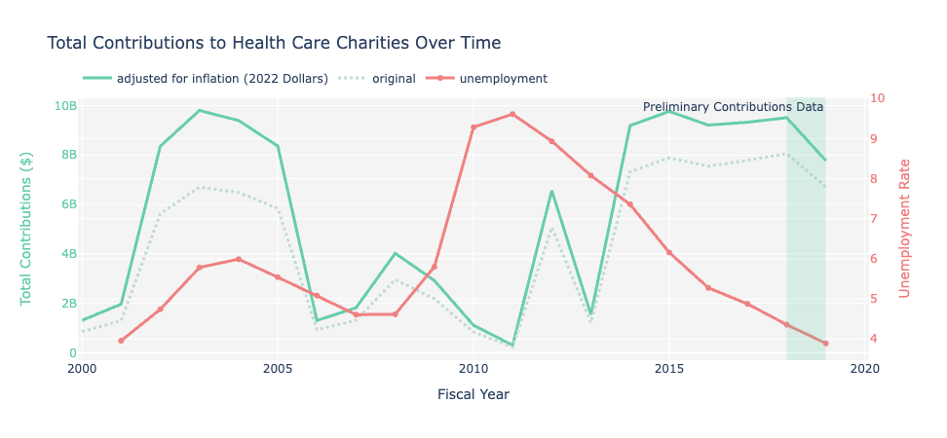
Results: Unemployment
Unemployment Source: Bureau of Labor Statistics

Slide 9
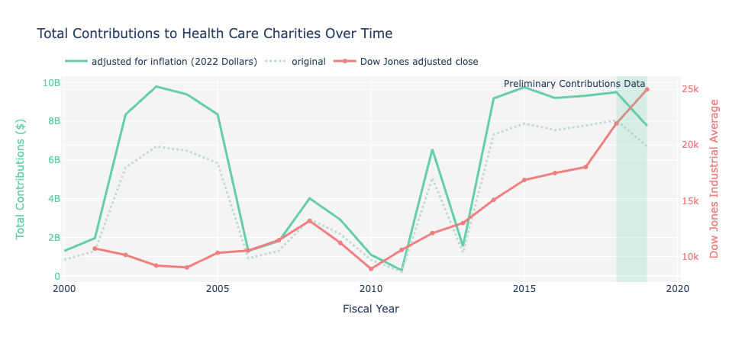
Results: Dow Jones
Dow Jones Industrial Average Source: Dow Jones Industrial Average - Yahoo Finance

Slide 10
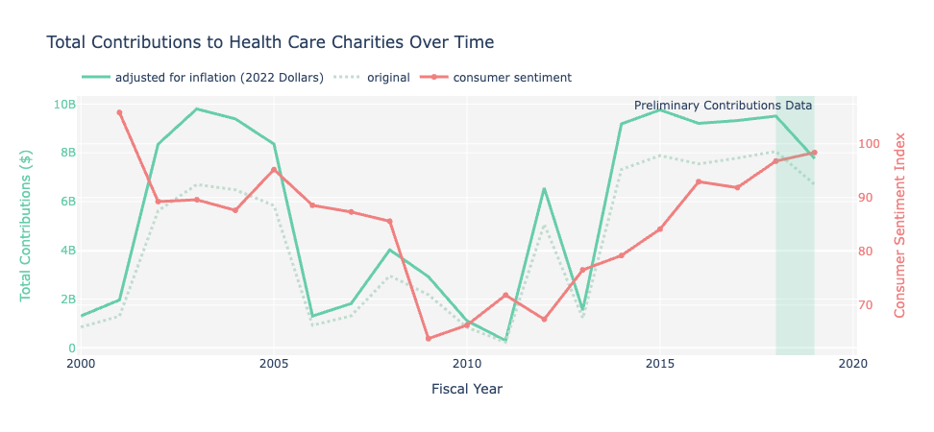
Results: Consumer Sentiment Index (CSI)
CSI Source: University of Michigan
Notes:
** Healthcare Charitable organizations

Slide 11
Results: Panel Study of Income Dynamics (PSID)
PSID is a biennial survey on households across the country
Tracking the same families (the reference person is the same from 2000 to 2020)
  2069 households over 20 years
Adjusted for inflation (in 2020 dollars)
Notes:
** Healthcare Charitable organizations

Slide 12
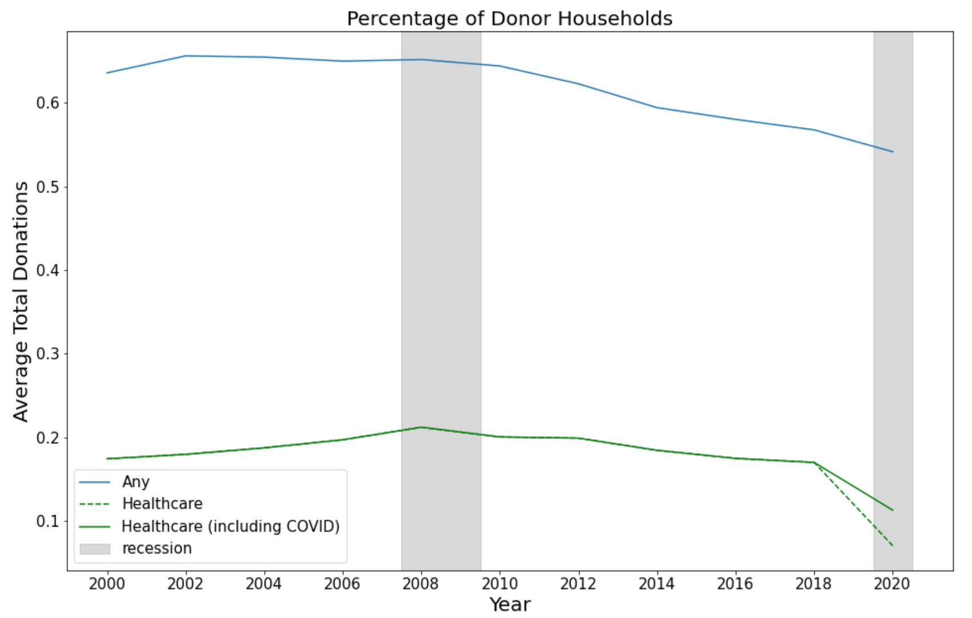
Results: PSID Descriptive Analysis
Proportion of Donor Households
Proportion
Notes:
** Healthcare Charitable organizations

Slide 13
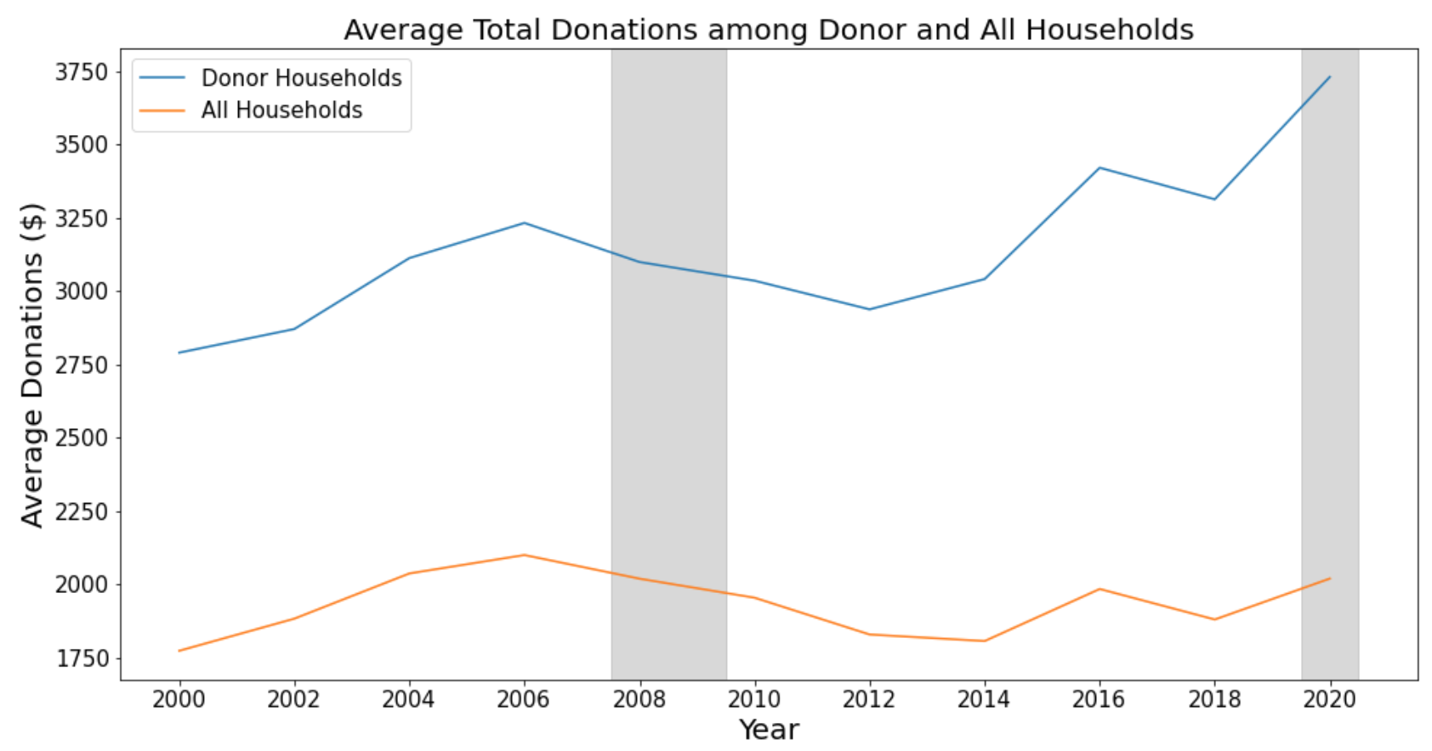
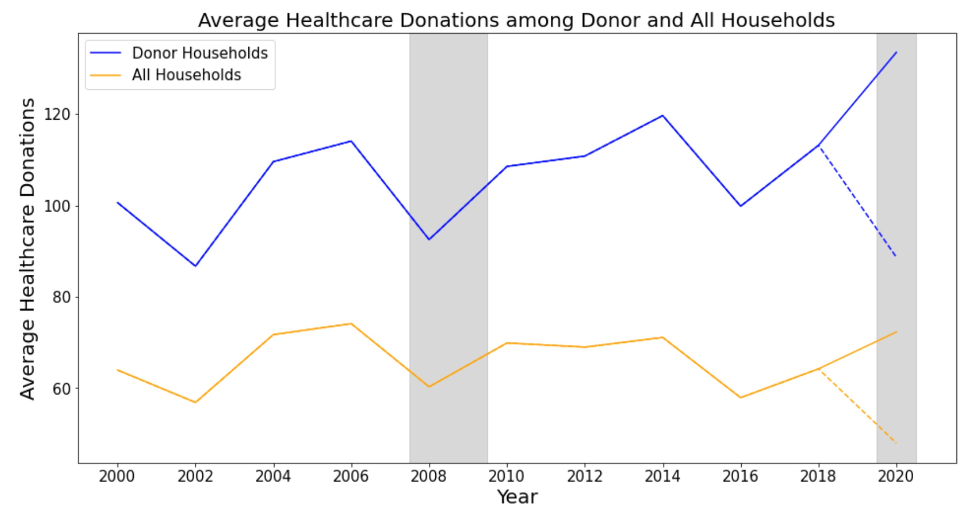
Results: PSID Descriptive Analysis
Notes:
** Healthcare Charitable organizations

Slide 14
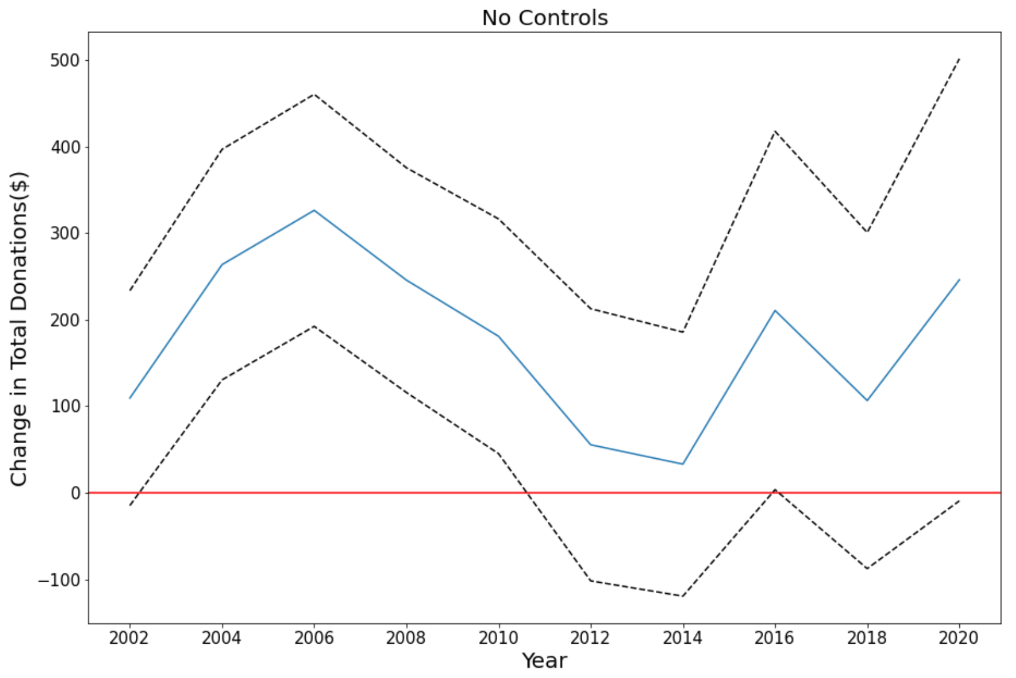
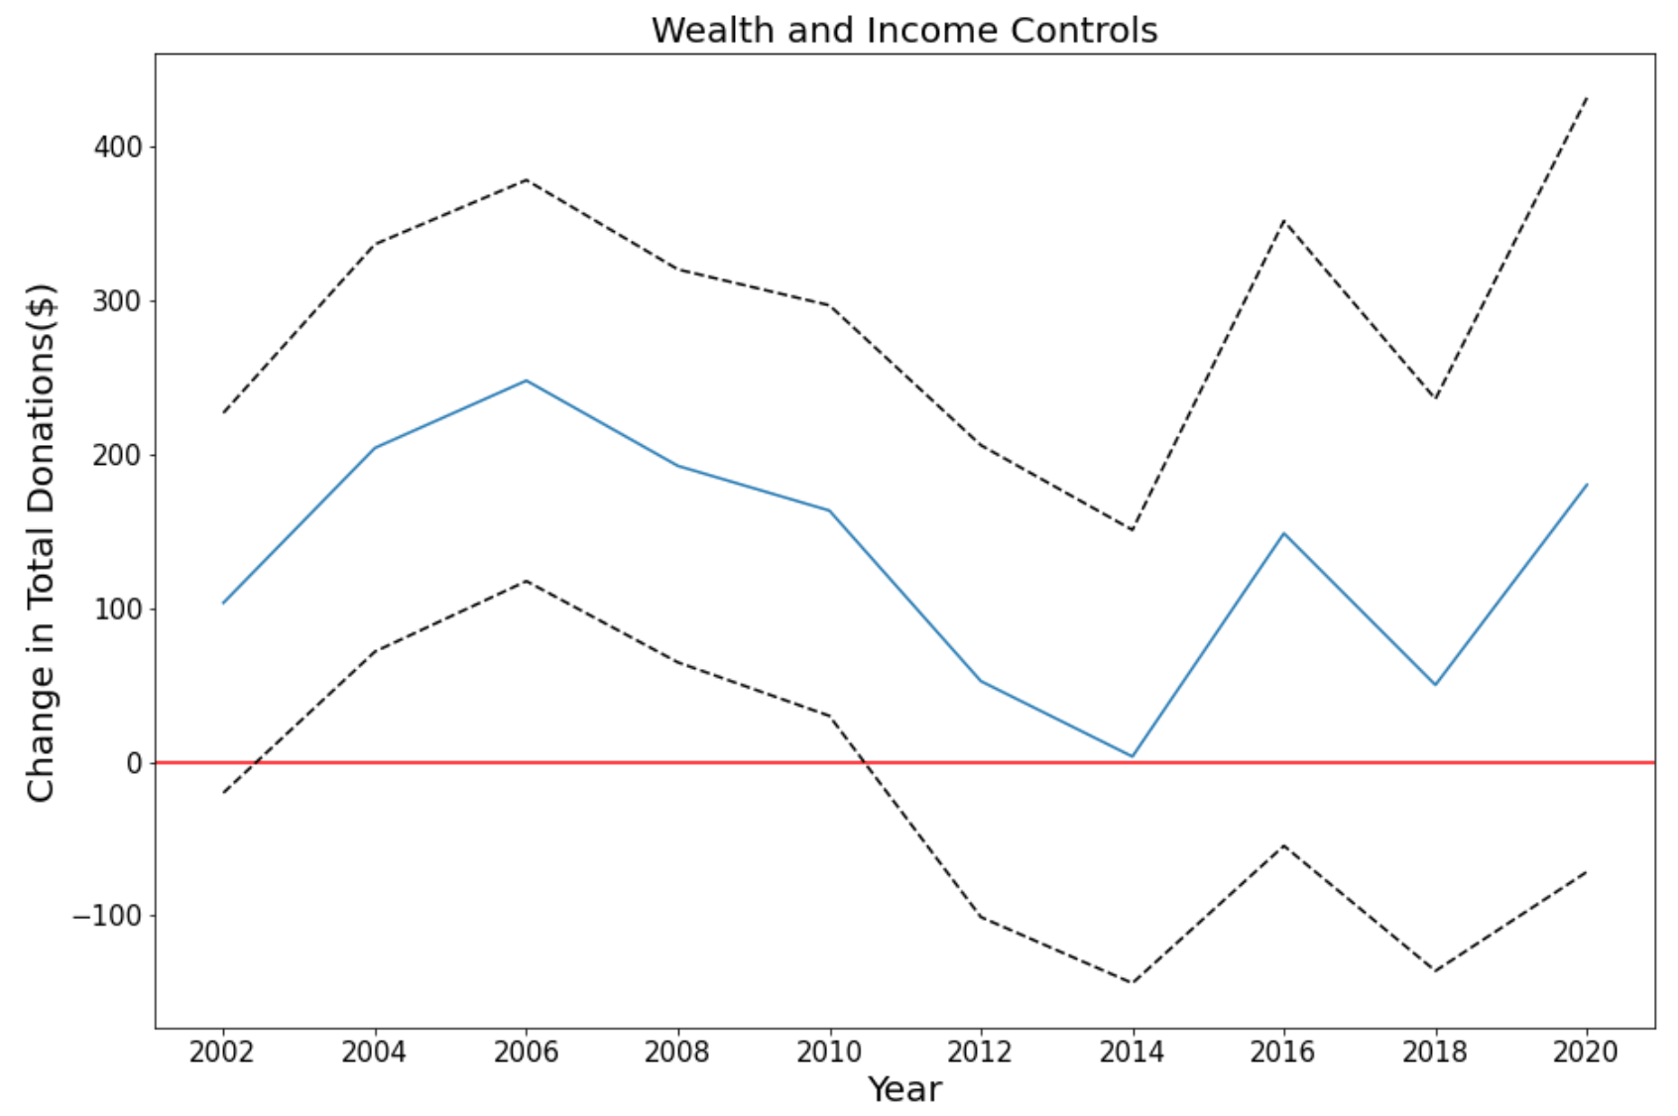
Results: PSID Panel Regression
Compared with 2000, we experienced significant increases
The increase in total donations in 2020 is marginally significant without wealth and income control.
The impact of 2008 recession on overall charitable giving is still in effect.
Notes:
** Healthcare Charitable organizations

Slide 15
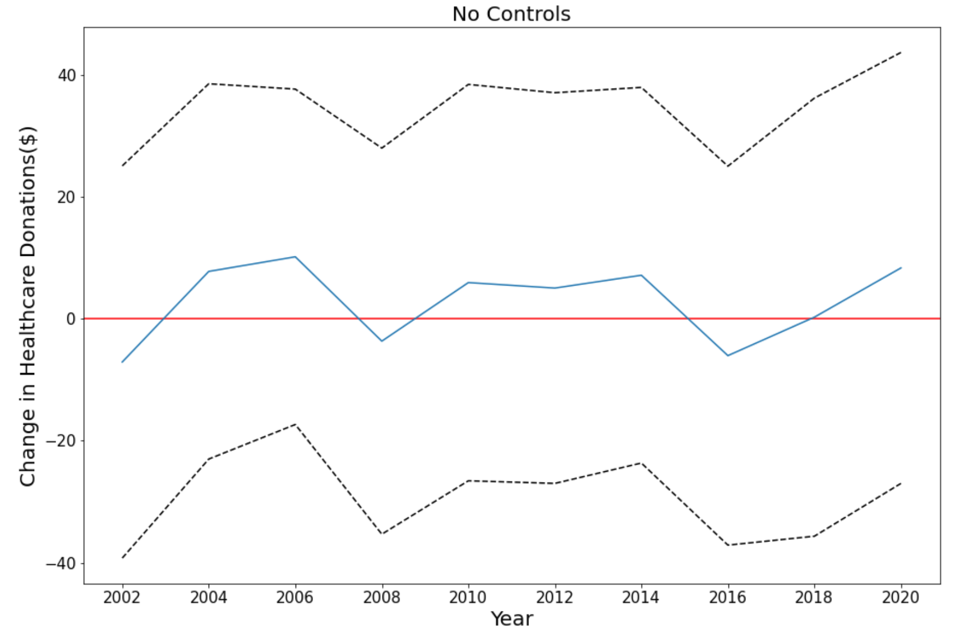
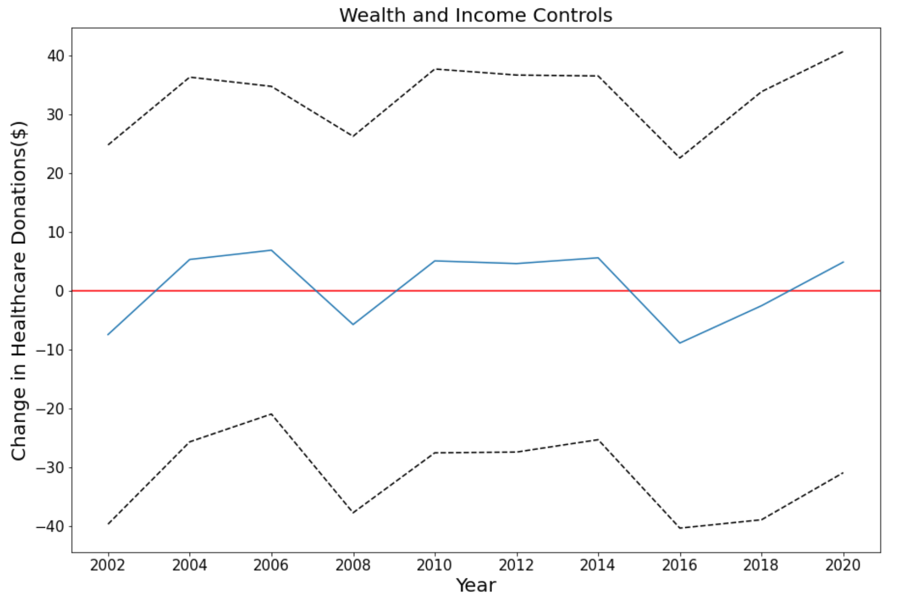
Results: PSID Panel Regression
Notes:
** Healthcare Charitable organizations

Slide 16
Discussion
  Healthcare charities fluctuate less with the economy than charities as a whole
  Limited longitudinal data makes it difficult to perform extensive analysis
  Our analysis is based on publicly available data
Notes:
** Healthcare Charitable organizations

Slide 17
Questions?

Slide 18
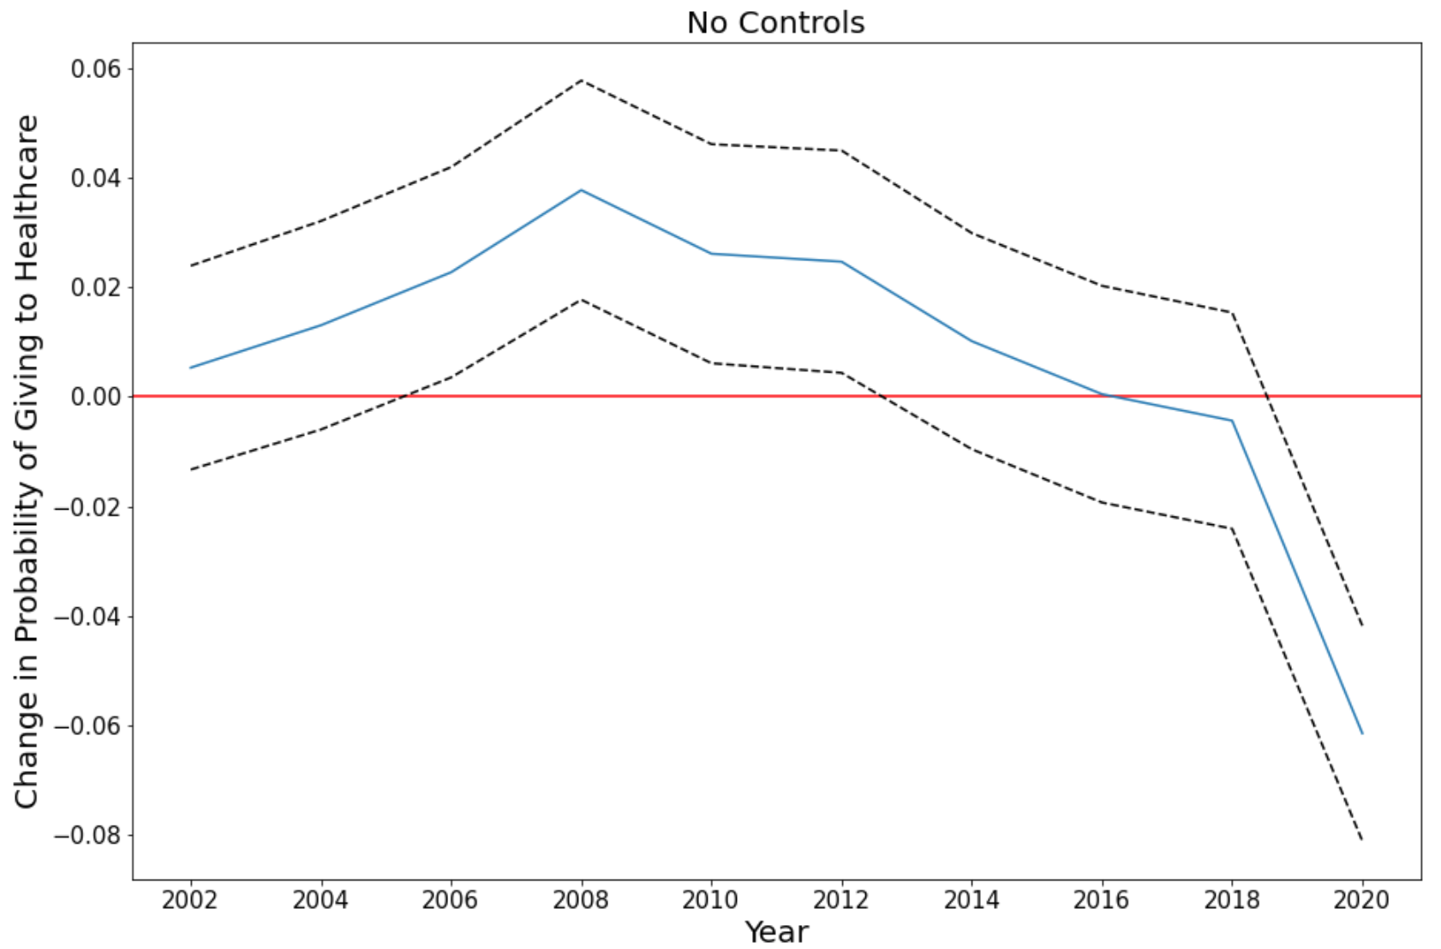
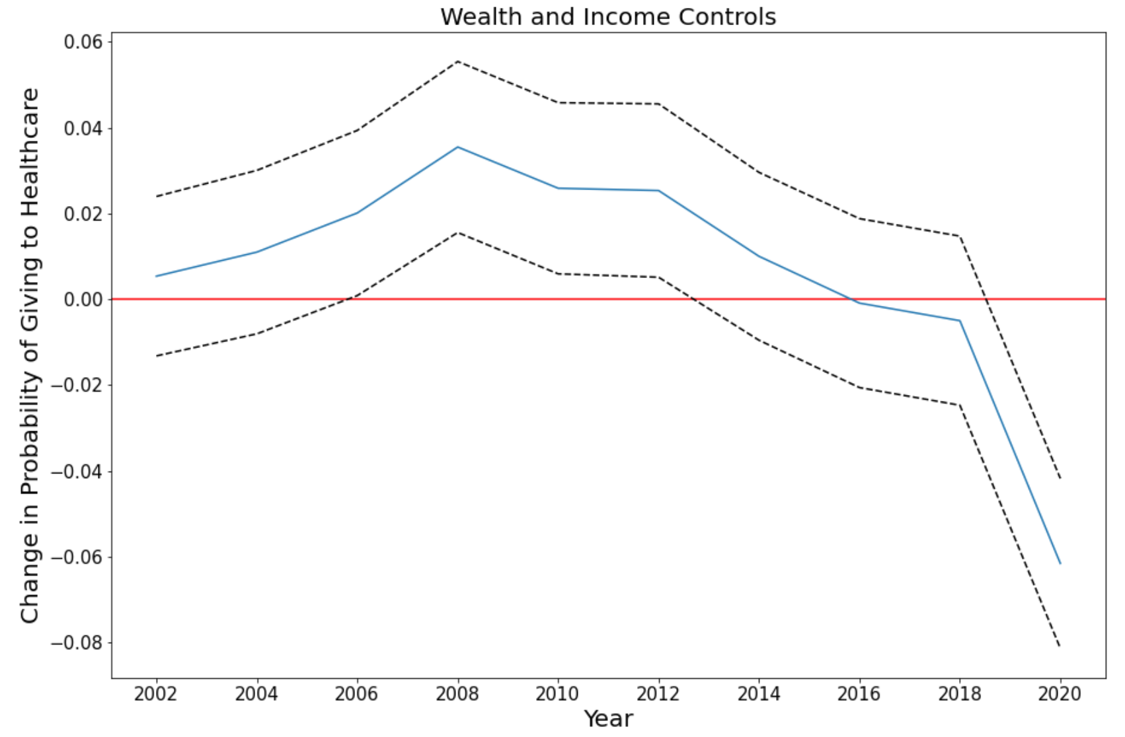
Results: PSID Panel Regression
Notes:
** Healthcare Charitable organizations

Slide 19
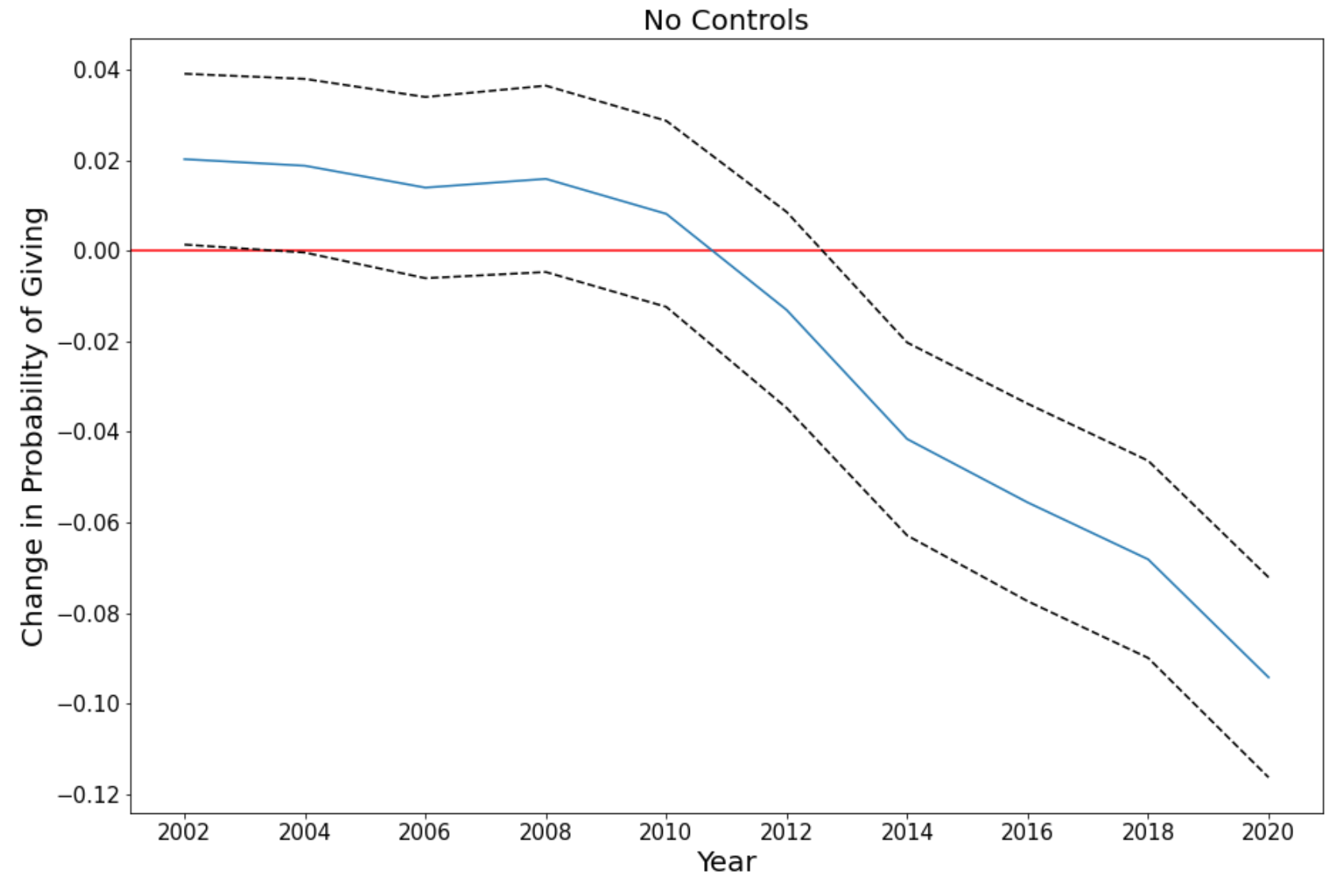
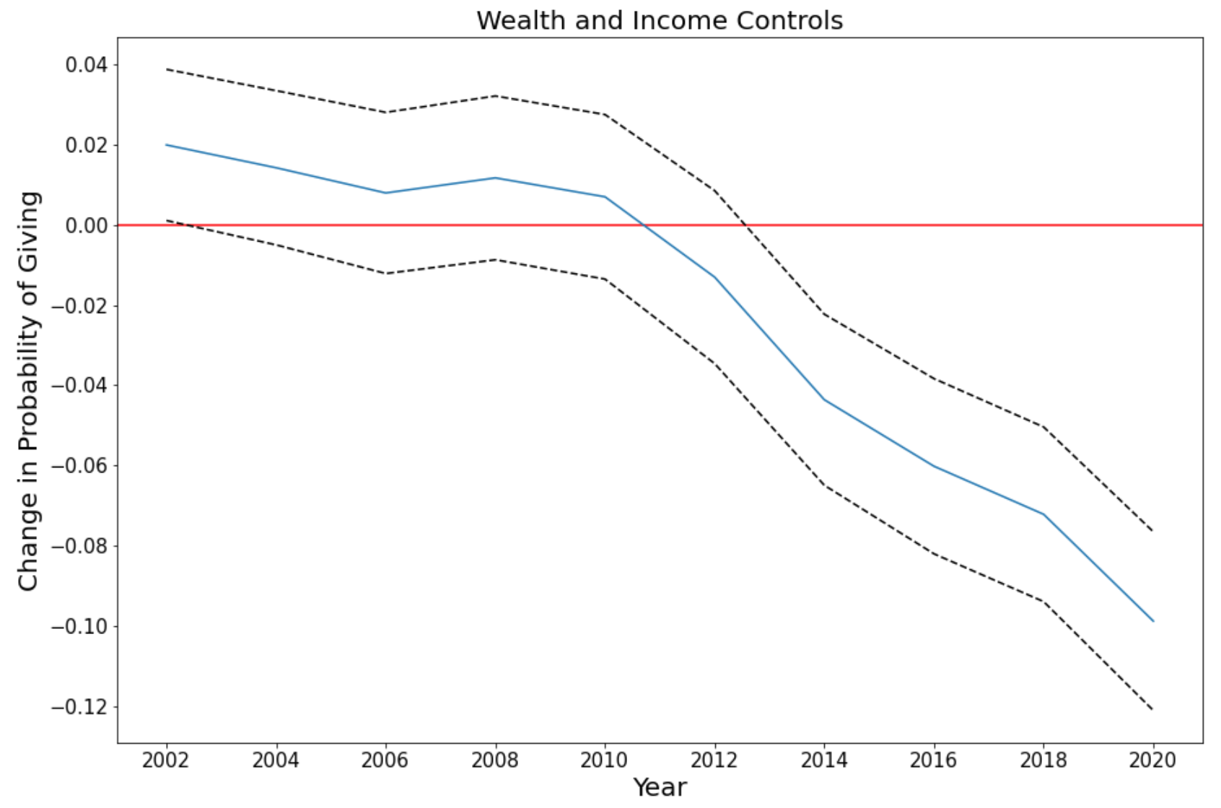
Results: PSID Panel Regression
Notes:
** Healthcare Charitable organizations

